Slide 1
PROOF OF CONCEPT

Slide 2
INTRODUCTION
The problem statement is regarding the attrition of employees in a company X. We are provided with a two sets of data out of which one gives the details of the ex-employees and the other gives the details of the current employees. We can solve this problem by analysing the data using Numpy and pandas. Thus, with the obtained useful information the current state of the working employees can be predicted easily.
Notes:
The problem statement is regarding the attrition of employees in a company X. We are provided with a two sets of data out of which one is the details of the ex – employees and the other is the details of the current employees. We can solve this problem by analysing the data using numpy and pandas. Thus, with the obtained useful information the current state of the working employees can be predicted easily

Slide 3
Satisfaction level
The satisfaction level of the employee is one of the main cause of attrition as an employee with less satisfaction level is more likely to leave to the company.
The first heatmap shows the satisfaction level of the first 200 ex – employees.
The second heatmap shows the satisfaction level of the first 200 currently working employees.
Thus from the heatmaps it is seen that employees with satisfaction level less than 0.4 are leaving the company.

Slide 4

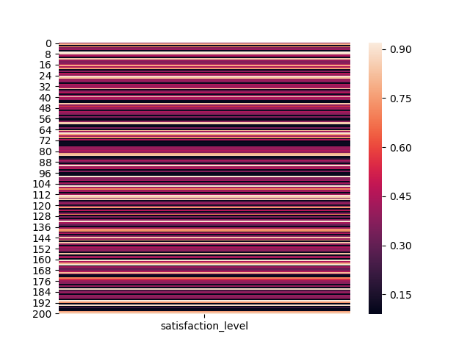
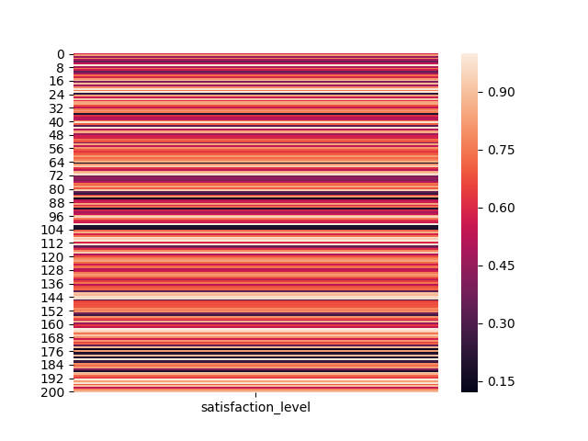
Sample Footer Text
2/24/2019
2

Slide 5
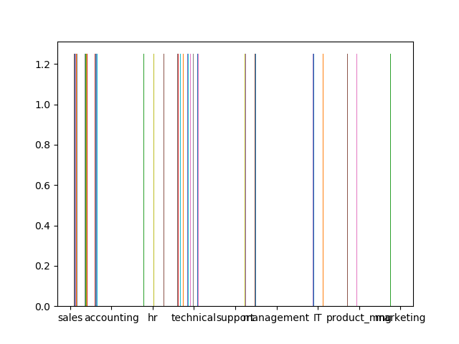
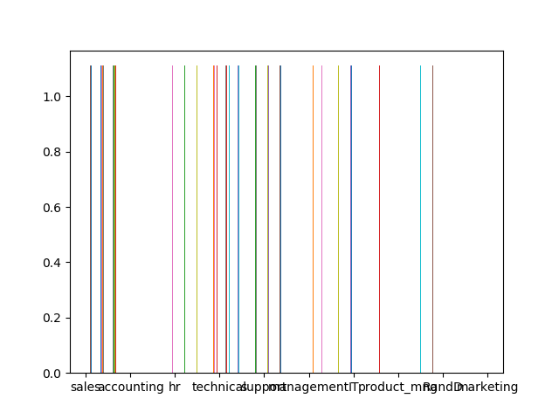
Department
From the histogram it is seen that most of the ex – employees are from the department sales and technical.
Employees may leave the company if they are not satisfied either with the working of the company or the company itself.
Thus the employees of the departments mentioned above are prone to leave.

Slide 6
Salary
Another important reason for attrition is less salary.
From the heatmap it can be seen that the employees those who left the company are mostly those who received low medium salary.
Hence the current employees who are being paid low are prone to leave the company.
Here the value 1 denotes low salary, 2 denotes medium salary and 3 denotes high salary.

Slide 7
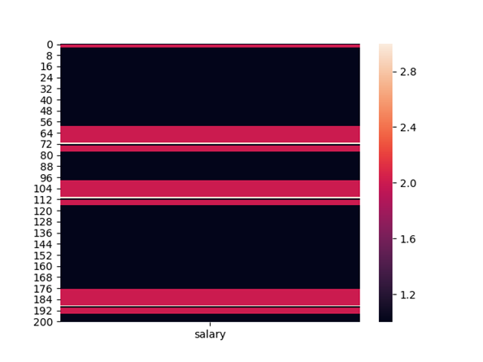
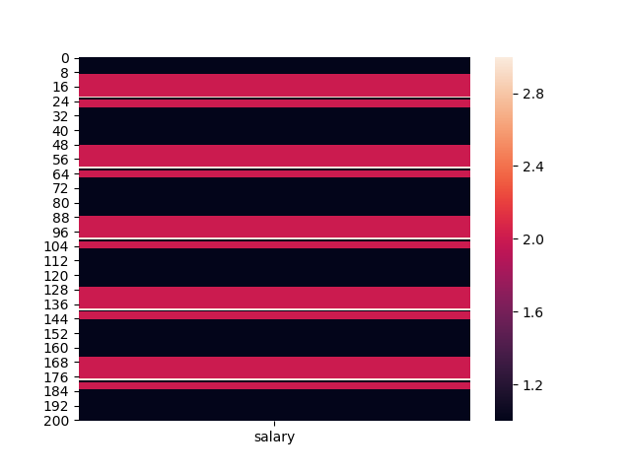
Sample Footer Text
2/24/2019
2

Slide 8
Monthly hours
The amount of hours that an employee has worked also affects attrition.
If an employee is made to work for a lot of hours, he might get agitated and start hating the job.
The ex – employees have worked either too much or too less and the middle value 200 does not have many values. This lead to attrition.
The graphs show the values of the monthly hours worked by the ex – employees and the present working employees

Slide 9
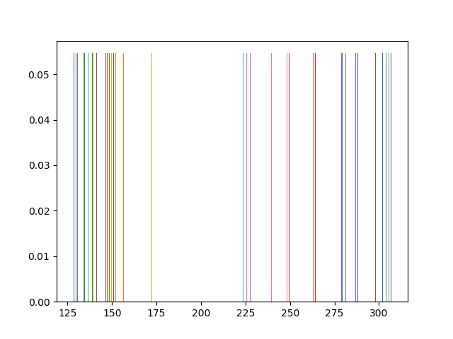
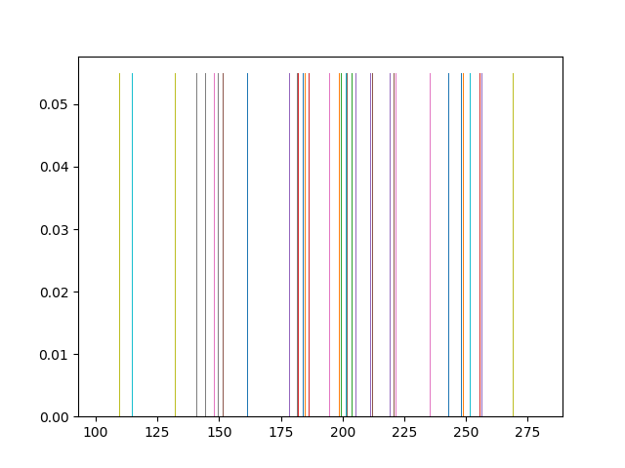

Slide 10
Work Accidents
Work accidents are unexpected events that may even lead to death.
The number of accidents which has been experienced by an employee is always 1 or less than 1 which means that when an employee meets with an accident he leaves the company.
So the employees currently working in the company have greater chances of leaving the company if they meet with an accident.
If a company has to make an employee who has met with an accident to stay in the company then it has to provide any one of these
1. High salary
2. High satisfaction
3. Promotion

Slide 11
Promotion
The most of the employees who have left the company have received no promotions throughout their job.
This is one of the main reason for the employees to lose their satisfaction in the job.
Hence, promoting worthy employees to higher levels is necessary for decreasing the attrition rate.

Slide 12
Solution
The most major reason for attrition is the Work accident.
Secondly, the salary pays a major role in the attrition. Hence, the salary paid must be either medium or high for the employees to prevent attrition.
The satisfaction level of the employee must be greater than 0.4 for a promising performance of the employee in the company.
Promotions have to be given to employees who have contributed well to the company. This prevents attrition as the employees will work with more interest and aim in achieving a promotion.
The satisfaction of employees can also be increased by addressing the problems of the employees frequently through meetings.

Slide 13
Solution
The monthly hours of work given to the employees must be around 200 which is neither less nor more.
If a department has greater attrition rate then the department should be checked for reasons for the attrition and they have to be rectified soon.
Assigning employees to their desired department can also solve the problem.
The number of projects alloted for an employee must be given based on the satisfaction and capability of the employee.

Slide 14
Summary
The given data was analysed with the help of numpy and pandas by visualising the data which gave a broad picture of the condition of the employees.
The categories based on which the employees left the company were understood.
Suggestions to decrease the attrition is given.

